Slide 1

ADVANCED CODE COLLABORATION SYNCER
Presented by
Srivignesh M (95072212153),
Sutharsun M (95072212162),
Sudharson A (95072212158).
PROJECT GUIDED BY,
DR.Euidol (PROF/CSE)

Slide 2
ABSTRACT
In today’s modern software development world, teamwork and real-time collaboration have become very important. Many developers work from different locations, and they need an efficient way to write and manage code together. Traditional code editors do not provide built-in real-time collaboration features, so developers depend on separate tools for communication and file sharing. This reduces productivity and makes collaboration difficult. To solve this problem, we propose a Collaborative Code Editor inspired by Visual Studio Code. Our system allows users to log in using their Google account, create or join secure coding rooms, and work on the same code simultaneously in real-time. It also includes a chat feature for communication between team members. The main aim of this project is to improve team collaboration, increase coding efficiency, and provide a modern web-based development environment similar to VS Code.

Slide 3
INTRODUCTION
Technology is rapidly evolving, and software development has become more collaborative than ever before. Modern development teams require tools that allow multiple programmers to work together efficiently, regardless of their physical location. Real-time collaboration reduces development time, improves communication, and enhances overall productivity. However, many traditional code editors are designed for individual use and lack integrated collaboration features.
To address this need, we developed a Collaborative Code Editor, a web-based platform that enables multiple users to write and edit code simultaneously in a shared environment. The system provides secure login, room-based collaboration, and integrated communication features. By combining real-time synchronization and an interface inspired by Visual Studio Code, this project aims to create an efficient and user-friendly coding experience for teams.

Slide 4
REVIEW OF LITERATURE
1. CodeFlow: Real-Time Collaborative Code Editor
Year & Journal:2024 & IEEE Explorer
Objective:
  To design and implement a real-time collaborative code editor that enables multiple developers to write and edit code simultaneously.
Methodology:
  Used modern web technologies including React.js, Node.js, Socket.IO and Web Sockets for real-time communication and synchronization across clients.
Key Contribution:
  Demonstrates a working collaborative code editor system where multiple users can edit together with minimal delay and full sync, emphasizing the use of real-time communication protocols and conflict handling strategies.

Slide 5
REVIEW OF LITERATURE
2. Real-Time Collaborative Code Editor: A Web-Based Synchronous Programming Platform
Objective:
  To design a web app to work together
Methodology:
  TF-IDF features; 10-fold cross-validation on 10,000 reviews.
Key Contribution:
  Enabled multiple users to edit code simultaneously.
Limitation:
  Limited scalability for many users.
Reference Link: https://www.ijraset.com/research-paper/real-time-collaborative-code-editor-a-web-based-synchronous-programming-platform

Slide 6
REVIEW OF LITERATURE
3.Enabling Seamless Software Collaboration: Web-Based Collaborative Code Editor
Objective:
  Improve team collaboration in coding.
Methodology:
  Client-server model with integrated chat.
Key Contribution:
  Combined code editing and communication.
Limitation:
  Needs better security handling.

Slide 7
REVIEW OF LITERATURE
4. Code Together: Real-Time Code Editor Application
Objective:
  To build a real-time collaborative coding tool that enhances teamwork and productivity.
Methodology:
  Implemented using modern web technologies with socket-based communication for instant updates.
Key Contribution:
  Shows the effectiveness of real-time synchronization in collaborative learning and development environments.
Limitation:
  Does not include advanced IDE features.

Slide 8
EXISTING SYSTEM
In the existing system, most developers use traditional code editors such as Sublime Text, Notepad++, or Visual Studio Code for writing and editing code. These editors are mainly designed for individual use and do not provide built-in real-time collaboration features. When developers need to work together, they share files manually through email or cloud storage platforms like Google Drive, and communicate using separate chat applications. This process is time-consuming and may lead to version conflicts, miscommunication, and reduced productivity. Therefore, the existing system lacks an integrated environment for real-time collaborative coding and communication.

Slide 9
PROPOSED SOLUTION
To overcome the limitations of the existing system, we propose a Collaborative Code Editor, a web-based platform that enables real-time collaborative programming. In this system, users can securely log in using their Google account and create or join coding rooms using a unique Room ID and password. Multiple programmers can work on the same code simultaneously, and all changes are synchronized instantly for every user in the room.
The system also includes an integrated chat feature that allows collaborators to communicate without using external applications. The editor interface is inspired by Visual Studio Code, providing a familiar and user-friendly coding environment. This proposed system improves teamwork, reduces version conflicts, and increases overall development efficiency.

Slide 10
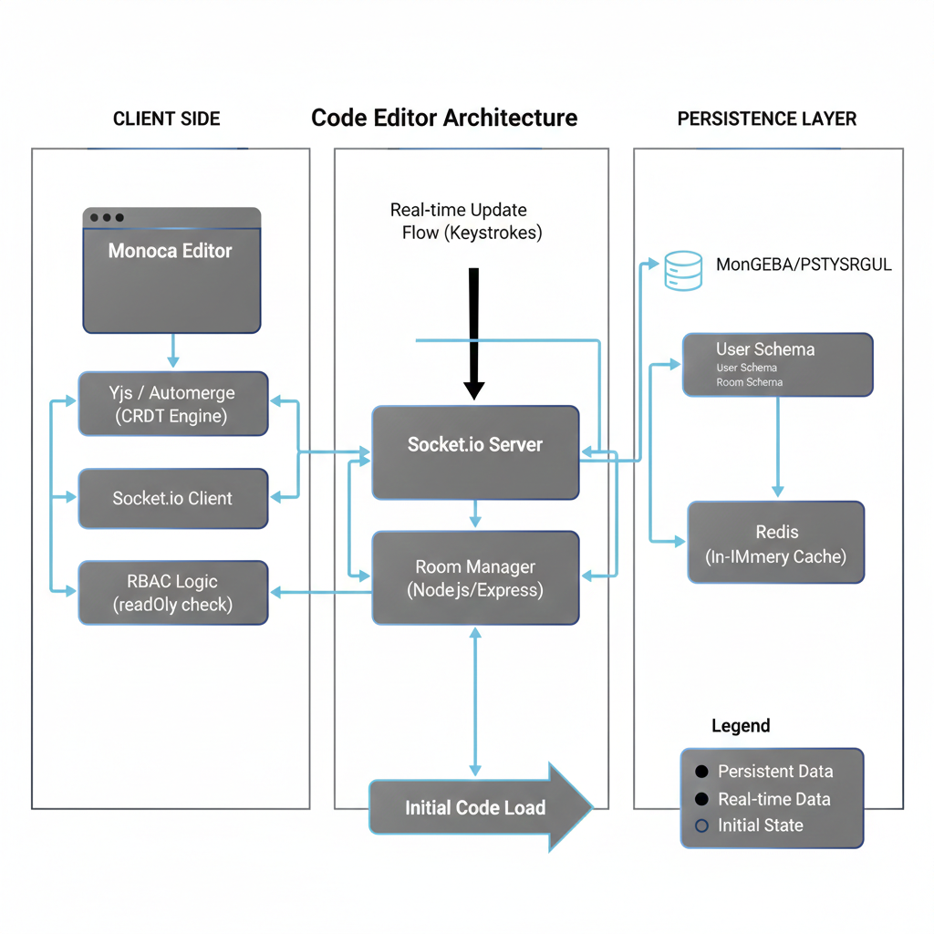
ARCHITECTURE DIAGRAM

Slide 11

MODULES

Slide 12
SOFTWARE & HARDWARE USED
SOFTWARE USED
  Tensorflow
  Scikit-Learn
  Matplotlib
  Seaborn
  Python Idle/IDE
HARDWARE USED
  HDD:10GB
  RAM:8GB above
  Processor:i5 Gen 8 above
  OS: Win 11

Slide 13
OUTPUT

Slide 14
OUTPUT

Slide 15
REFERENCES
1.K. Sharma, R. Patel, “Real-Time Collaborative Code Editor Using Web Sockets (2022)”.Design of a web-based collaborative code editor using Web Sockets for real-time synchronization and multi-user editing.
2. M. R. Khan, S. Verma,” Design and Implementation of Web-Based Collaborative IDE (2023)”. Development of a browser-based IDE supporting multi-user collaboration and integrated chat system.
3.Y. Liu, H. Zhang, “Efficient Conflict Resolution in Real-Time Collaborative Editing Systems (2023)”.Improved conflict resolution techniques using optimized Operational Transformation algorithms.
4. P. Nair, T. Joseph,” Scalable Real-Time Collaboration Using CRDT in Distributed Applications (2024)”. Use of CRDT to improve scalability and consistency in collaborative web applications.

Slide 16
CONCLUSION
The Collaborative Code Editor project provides a modern solution for real-time collaborative programming. It allows multiple users to work together in a shared coding environment with secure login, room-based access, and integrated chat support. By combining real-time synchronization and a user-friendly interface inspired by Visual Studio Code, the system improves teamwork and coding efficiency.This project demonstrates how web technologies and real-time communication tools can be used to build an effective collaborative development platform.
In the future, the system can be enhanced with advanced features such as version control integration, debugging support, and multi-language execution.

Slide 17
THANK YOU!

